Slide 1
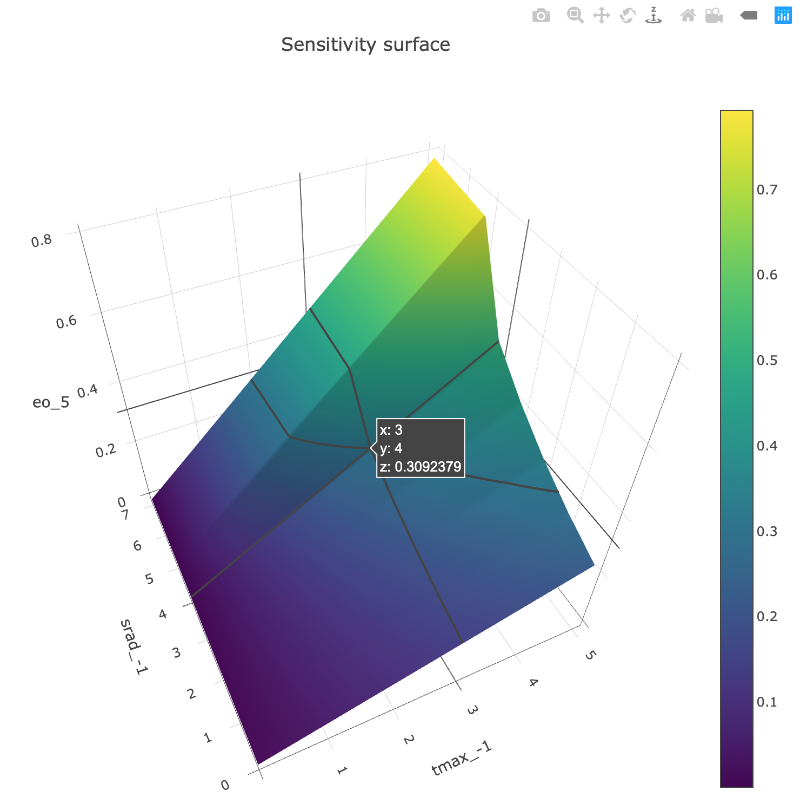
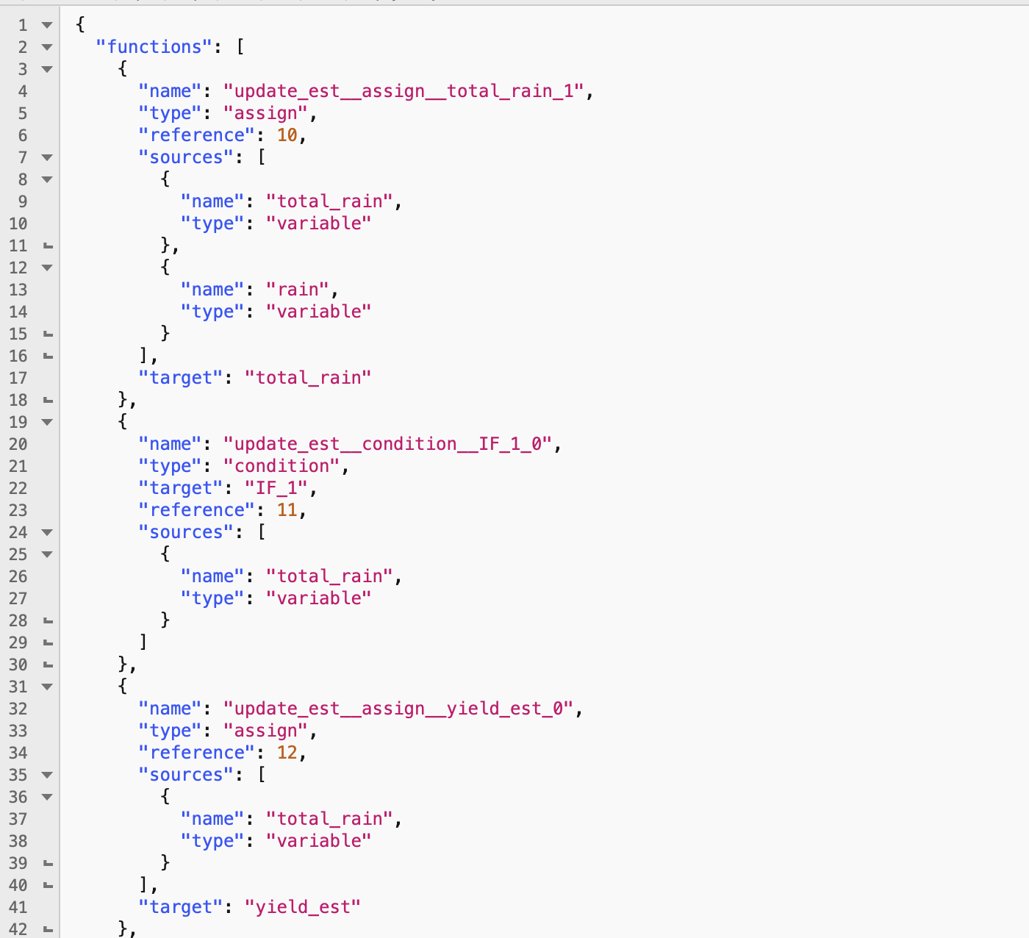
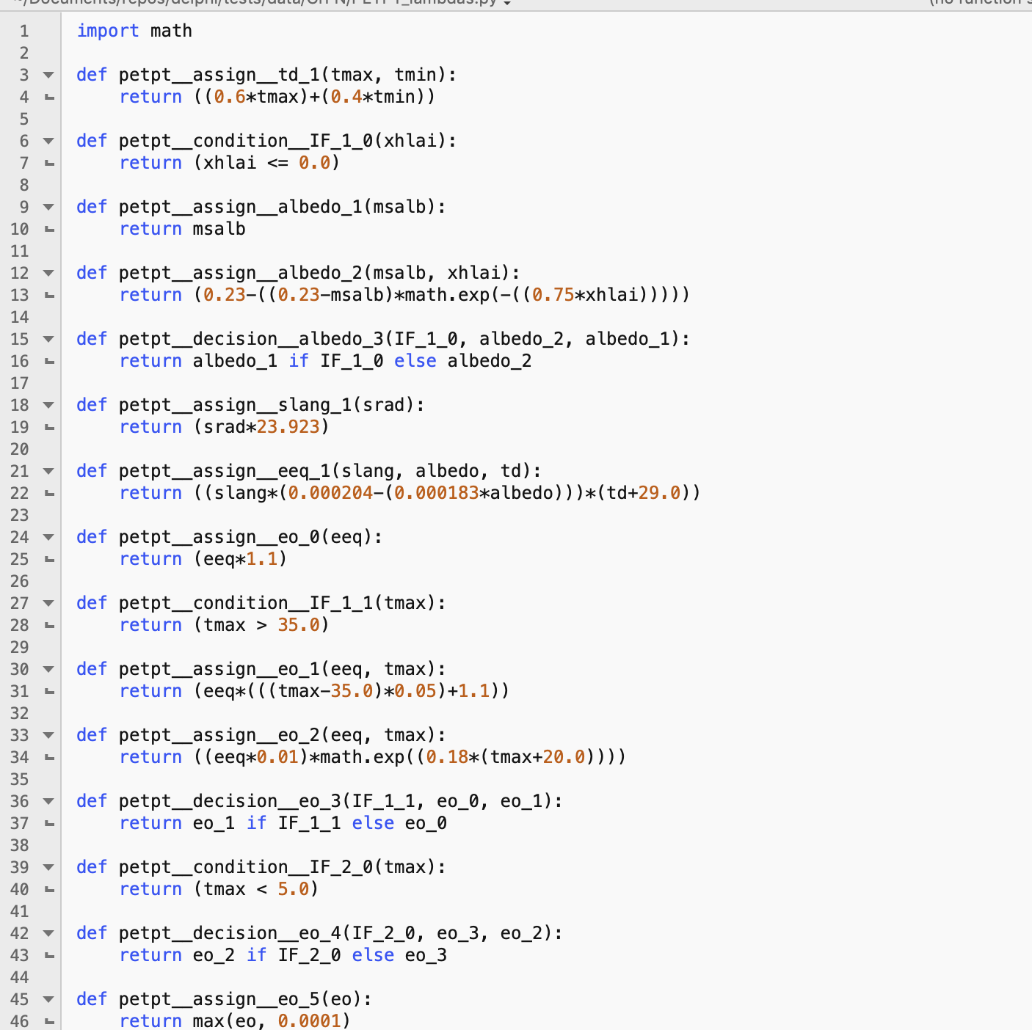
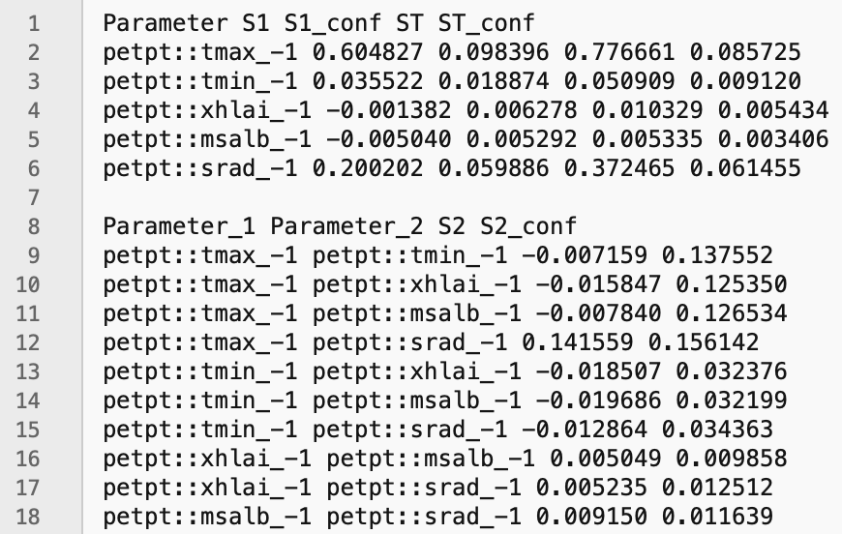
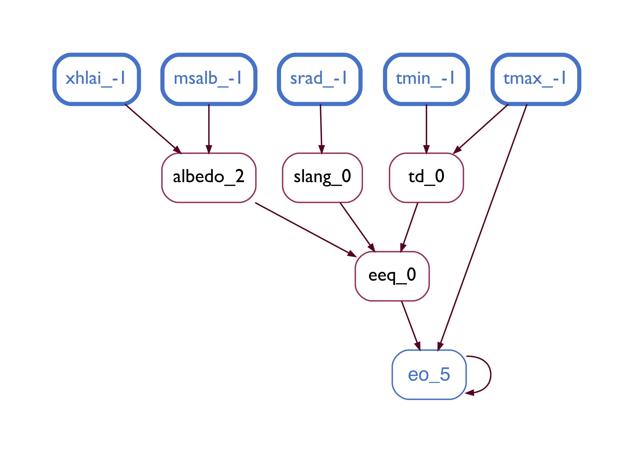
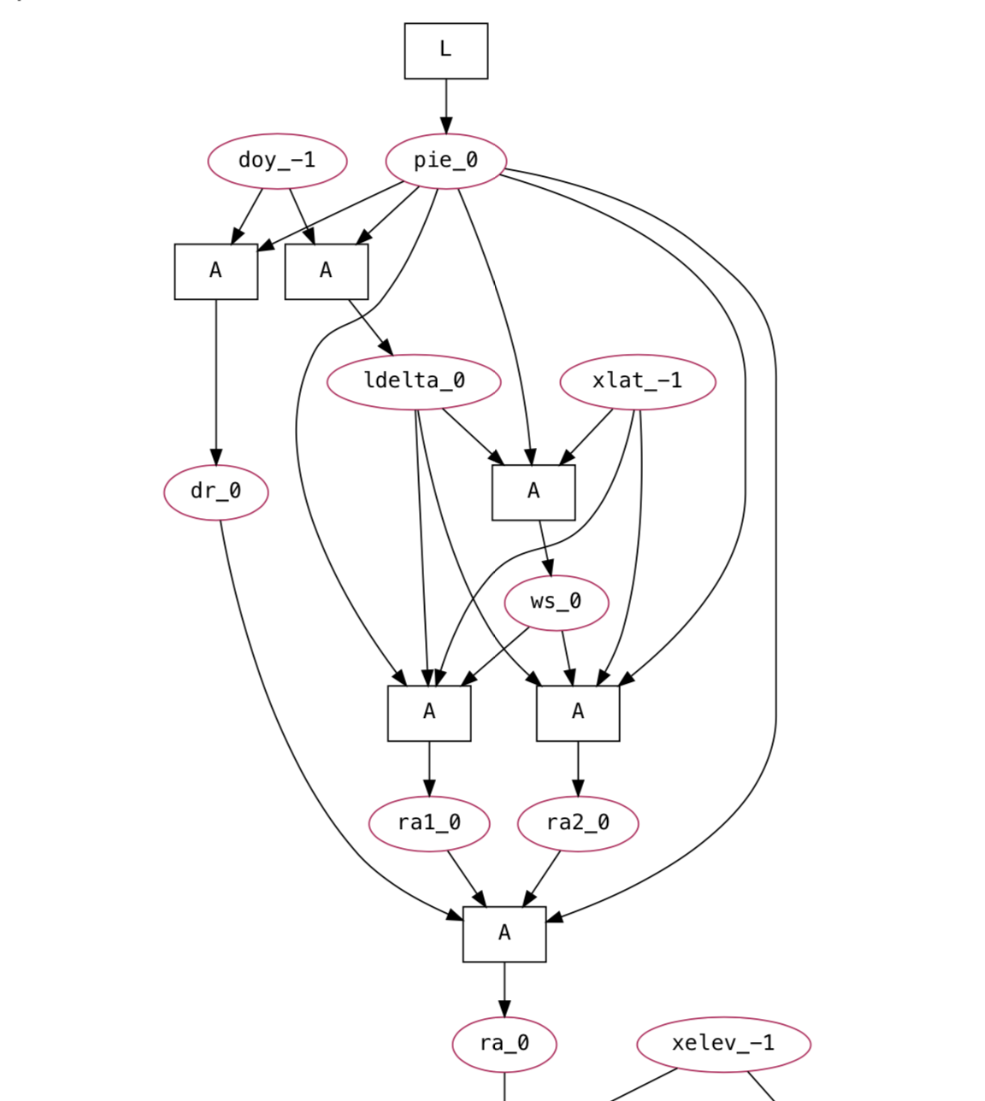
Model Analysis
Sensitivity
Surface
GrFN
GrFN CG
Computation Graph Generation
Sensitivity Analysis
(SALib)
Model Report
Lambdas
Model Comparison
FIB
FIB Generation
Sensitivity
Indices
Additional
GrFN CG
: Third-party software

